Slide 1


INTRODUCTION TO DATA ANALYTICS

Slide 2

Today’s Agenda
1.Introduction
2.Rules and regulations for the class
3.Agreeing on time for classes
4.Selecting our Class representatives and assistant
5.Sub-grouping and selecting sub-group leaders using this
5. Introduction to Data analytics and AI

Slide 3

What I would be teaching you in this cohort
1.Introduction to data analysis and AI
2.Statistics and Probability
3.Excel
4.Power BI
5.Python
6.Python Libraries for data science
7.Machine Learning
8.Deep learning
9.API and requests
10.SQL and Introduction to Data engineering

Slide 4
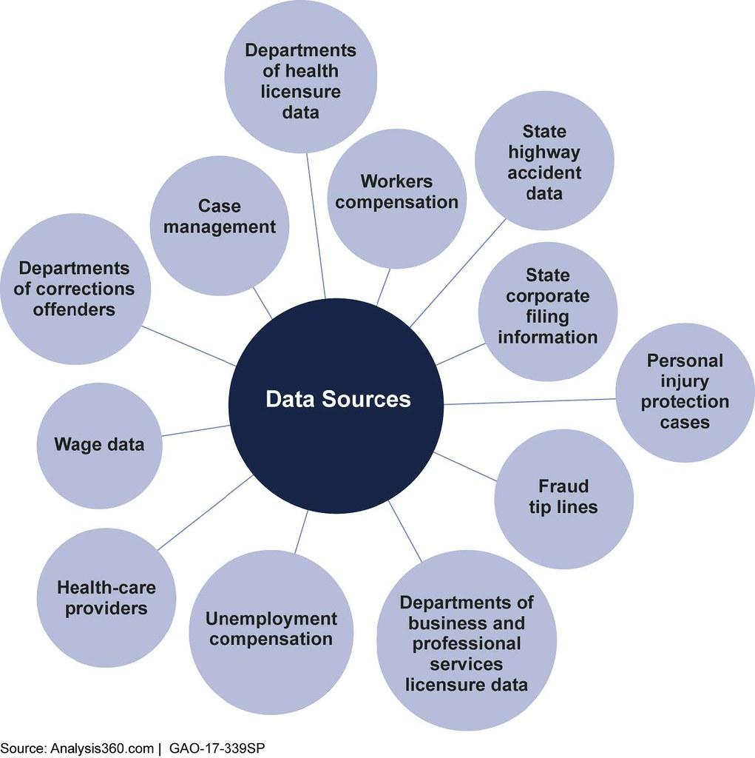
INTRODUCTION TO DATA ANALYTICS
What is Data?
Data is information in raw form, such as numbers, text, images, or videos. It can be collected from various sources like surveys, sensors, or databases. Data helps us understand patterns, make informed decisions, and gain insights.
What is Data Analytics?
Data analytics is the process of examining and interpreting data to uncover meaningful patterns and insights. It involves using tools and techniques to analyze large datasets and extract valuable information.
Data analytics helps businesses and organizations make data-driven decisions and solve complex problems.

Slide 5
INTRODUCTION TO DATA ANALYTICS
Applications of Data Analytics:
Marketing and Sales: Analyzing customer data to understand preferences, optimize marketing campaigns, and improve sales strategies.
Finance and Banking: Detecting fraudulent transactions, managing risks, and predicting market trends.
Healthcare: Analyzing patient data to improve diagnoses, identify disease patterns, and develop personalized treatment plans.
Operations and Supply Chain: Optimizing inventory management, predicting demand, and improving overall efficiency.
Social Media and Web Analytics: Analyzing user behavior and improving user experience.

Slide 6
INTRODUCTION TO DATA ANALYTICS
What is Data Analytics
Big data analytics uses a large amount of data through structured
examination to uncover hidden patterns, trends, correlations and insights
that can be inferred. Using today's technology, it is possible to analyze a
large volume of data and uncover answers immediately. In previous times,
this process used to be very slow and less efficient with more traditional
business intelligence solutions.

Slide 7
INTRODUCTION TO DATA ANALYTICS
Evolution of Big Data Analytics The applicability and theories of data analytics have been around for
decades; considering that if most organizations capture correctly the information that streams into their
businesses, it is easy to apply analytics
and get significant insights from these data. In the 1950s, prior to the broad adoption of the term Big
Data, businesses used simple analytics in the form of spreadsheets, examining numbers manually and uncovering
insights and trends.
The new benefits that big data analytics brings to the table, however, are speed and efficiency. Whereas a few
years ago a business would have gathered information, run analytics and unearthed information that could
be used for future decisions, today that business can identify insights for immediate decisions. The ability to work
faster – and stay agile – gives organizations a competitive edge they didn’t have before.

Slide 8
INTRODUCTION TO DATA ANALYTICS
The evolution of Big Data includes a number of preliminary steps for its foundation, and while looking back to the past might not be too
functionally useful for the growth of data volumes today, the point remains that “Big Data” is a relative term depending on who is discussing it.
For instance, Big Data to Amazon or Google is very different than Big Data to Paga which is a Nigerian-based Fintech company, but no less “Big” in the minds of those contending with it. Also, it is imperative to know that the volume of Data in the debate might also depend on the industry. For instance, a Lagos based NGO might have a relatively small amount of data
compared to a Pan-African bank like Standard Bank Group.
Out of the Box
Big data is still an enigma to many people because it is a relatively new term that was only coined during the latter part of the last decade. While it may still be ambiguous to many people since it’s inception it’s become increasingly clear what big data is and why it’s important to so many different companies.
The term big data doesn’t just refer to the enormous amounts of data available today, it also refers to the whole process of gathering, storing and analyzing that data. Importantly, this process is being used to make the
world a better place.

Slide 9
INTRODUCTION TO DATA ANALYTICS
Why is Big Data Analytics Important?
Big data analytics helps organizations harness their data and use it to identify new opportunities. That, in turn, leads to smarter business moves, more efficient operations, higher profits and happier customers. These are
some ways, according to evidence from recent Global studies, that Big Data Analytics can be of great importance to businesses:
Cost reduction. Big data technologies such as Hadoop and cloud-based analytics bring significant cost advantages when it comes to storing large amounts of data – plus they can identify more efficient ways of doing
business. Faster, better decision making. With the speed of Hadoop and in-memory analytics, combined with the ability to analyze new sources of data, businesses are able to analyze information immediately – and make
decisions based on what they’ve learned.
New products and services. With the ability to gauge customer needs and satisfaction through analytics comes the power to give customers what they want. Davenport points out that with big data analytics, more companies are creating new products to meet customers’ needs.

Slide 10

INTRODUCTION TO DATA ANALYTICS
Data Analytics Process:
Define the Problem: Clearly identify the objective and determine what insights are needed.
Data Collection: Gather relevant data from various sources, ensuring its accuracy and completeness.
Data Cleaning and Preprocessing: Remove errors, handle missing values, and format data for analysis.
Data Analysis: Apply statistical methods and algorithms to extract insights from the data.
Interpretation and Visualization: Communicate findings effectively through visualizations, charts, or reports.
Decision Making: Use the insights gained to make informed decisions and take appropriate actions.
Remember to keep the slides concise, visually appealing, and use relevant examples or graphics to enhance understanding.

Slide 11
INTRODUCTION TO DATA ANALYTICS
Data Engineering
Data Engineers are responsible for designing, developing, and maintaining the infrastructure required for storing and processing data. They have expertise in building scalable, robust, and fault-tolerant data pipelines. Data Engineers are required to have a strong understanding of database technologies, data warehousing, and ETL (Extract, Transform, Load) processes. They need to have a good understanding of various programming languages like SQL, Python, and Java and have experience in working with Big Data platforms like Hadoop and Spark.
Data Scientist
Data Scientists use advanced analytics technologies to derive insights from data. Their primary responsibility is to develop and implement algorithms and models that can interpret large datasets. They work on predictive modeling, machine learning, and statistical analysis to uncover hidden patterns and correlations. Data Scientists are required to have a strong background in statistics and mathematics, as well as proficiency in programming languages like Python and R. They also need to have a good understanding of Big Data platforms, as they need to work with large datasets

Slide 12
INTRODUCTION TO DATA ANALYTICS
Data Analyst
Data Analysts focus on interpreting data to uncover insights that can support business decisions. They are responsible for collecting, processing, and analyzing data from multiple sources. They also create visualizations and reports to support communication of data-driven insights to stakeholders. Data Analysts are required to have strong analytical skills and proficiency in tools like SQL, Excel, and Tableau. They must have an understanding of statistics and have experience in data processing.
What tools do i need to learn?
Power BI
EXCEL
Tableau
SQL
PYTHON etc

Slide 13
Career opportunities In Data Science and Analytics
Data Scientist
Data Visualist/ storyteller
Data Journalist/ Data Researcher
Data Analyst
Data Engineer
Analytical Engineer
AI Engineer
Machine Learning Engineer/scientist
Product Data Analyst
Business Intelligence analyst / Developer
Data Architecture
Data ops
Database Engineer
Statistician

Slide 14
Materials/ Reference
Materials on python
Automate-the-boring-stuff-with-python
Python series- Youtube
Python-for-Data-Science-and-Machine-Learning-Bootcamp
Python for beginners
Materials on Data Analyst
Material on how to start your data analyst career
Materials on Excel
Excel for Beginners
Materials on Data Analysis
Introduction to Tableau
Introduction to Power BI
Introduction to SQL
Other useful resources
PDF on Data science and Analytics
Teach yourself SQL

Slide 15
What do you think Artificial Intelligence is?

Slide 16
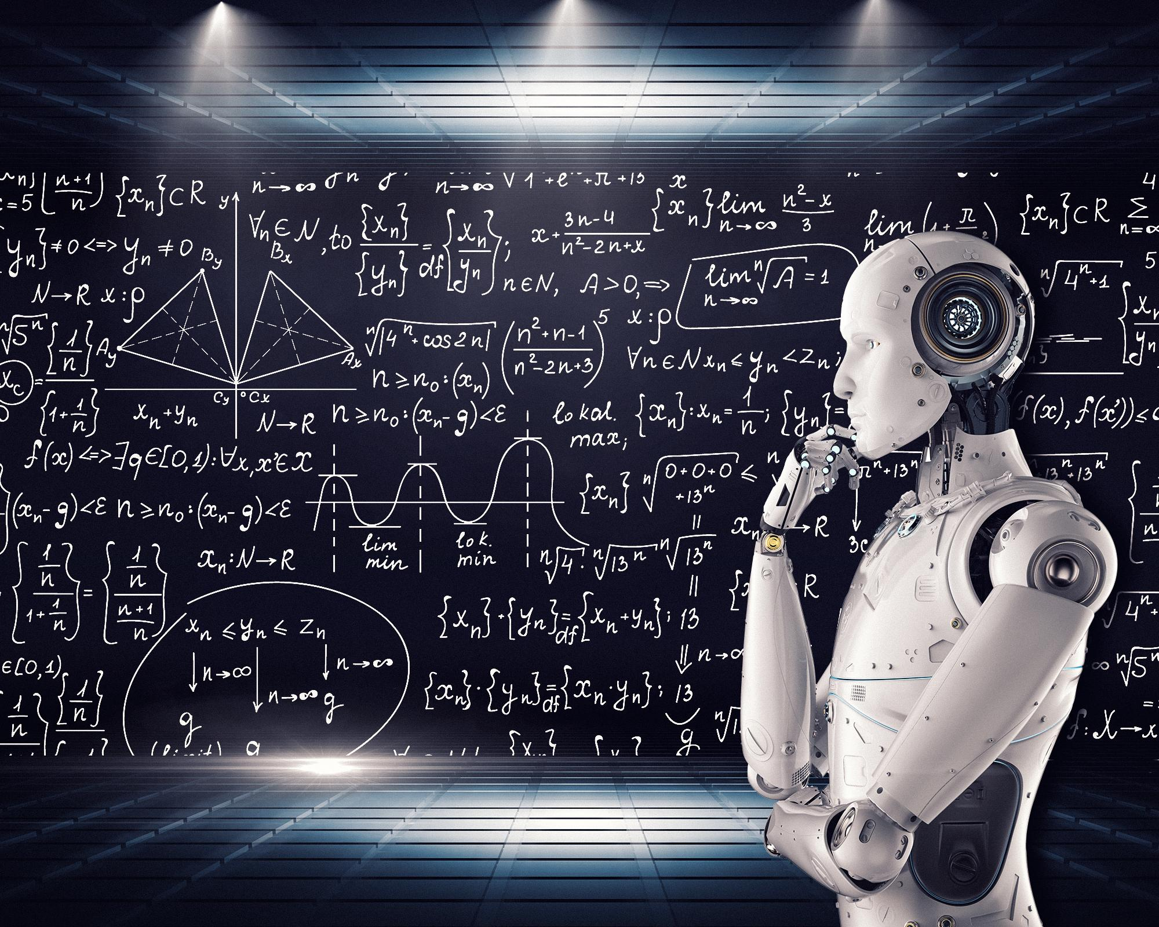
what is Artificial Intelligence
For years, people viewed computers as machines which can perform mathematical operations at a much quicker rate than humans.​
Then, scientists, and researchers' wonders how would we write algorithms for these tasks:​
A song comes on the radio, most listeners of music can quickly identify the genre, maybe the artist, and probably the song.​
An art critic sees a painting he’s never seen before, yet he could most likely identify the era, the medium, and probably the artist.​
A baby can recognize her mom’s face at a very early age.​
The simple answer is that you can’t write algorithms for these. Algorithms use mathematics.​
So, how we achieve this?​

Slide 17
AI continued
Scientists found that: humans were able to achieve these results because they learned to do these things over time.​
Simply put, AI means to program a machine to behave like a human (simulate human beings). ​
The terms Artificial Intelligence(AI) have been used since the 1950s. At that time, it was viewed as a futuristic, theoretical part of computer science.​

Slide 18
Is Machine learning also AI?

Slide 19
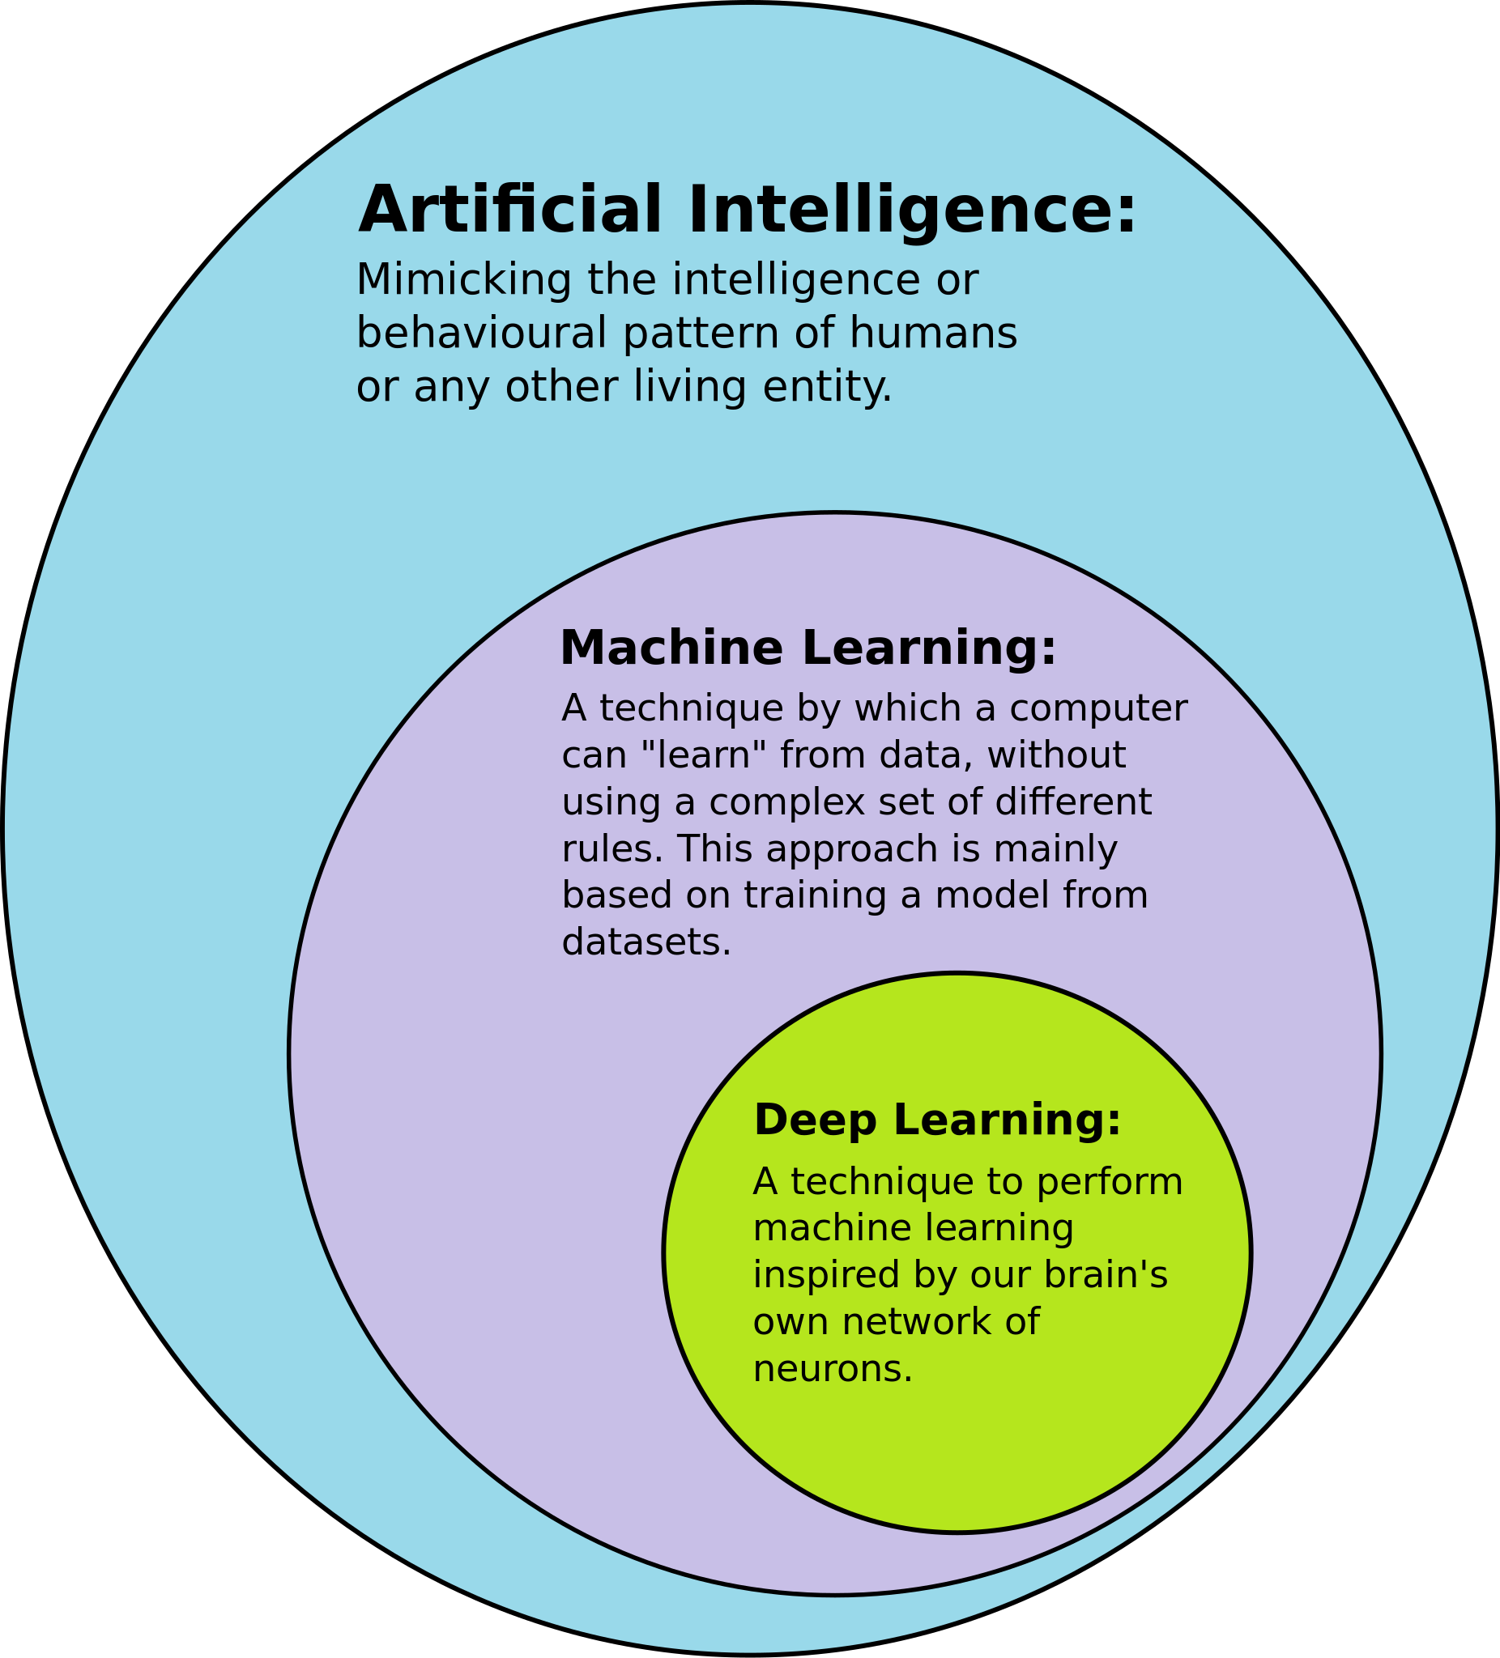
Machine learning is a branch of AI
Machine learning is the main branch of artificial intelligence.​
In machine learning, numerical data is used to train computers to complete specific tasks.​
ML programs does not have to be explicitly programmed to solve the problems.​
An algorithm is nothing more than a series of instructions followed by a computer, and ML is like an intelligent algorithm.

Slide 20


Thank You
see you in the next class

